Slide 1
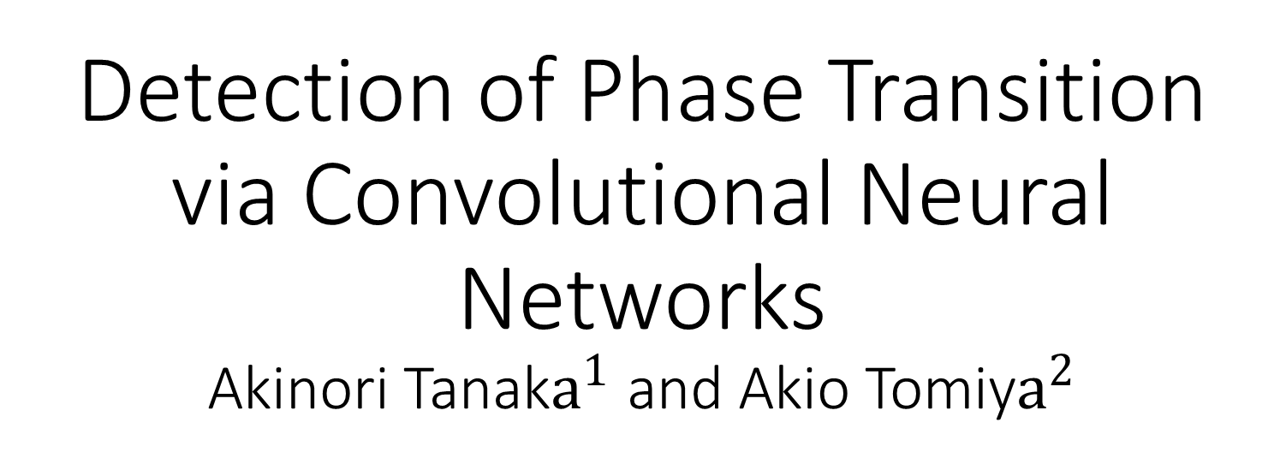
Detection of Phase Transition via Convolutional Neural Networks Akinori Tanak$a^{1}$ and Akio Tomiy$a^{2}$
$${\text{Interdisciplinary} \text{Mathematical} \text{and} \text{Computational} \text{Collaboration} \text{Team}\text{, }\text{RIKEN}\text{, }\text{Wako}\text{, }\text{Saitama}\text{ 351−0198, }\text{Japan}}^{1}$$
$${\text{Key} \text{Laboratory} \text{of} \text{Quark}\text{ \& }\text{Lepton} \text{Physics}\text{ (}\text{MOE}\text{) }\text{and} \text{Institute} \text{of} \text{Particle} \text{Physics}\text{, }\text{Central} \text{China} \text{Normal} \text{University}\text{, }\text{Wuhan}\text{ 430079, }\text{China}}^{2}$$
For the Machine Learning final project presents Alvaro G. de la Torre Navarro
DCI. Universidad de Guanajuato. Loma del Bosque 103, Lomas del Campestre CP 37150
León, Gto., México

Slide 2


$$Outline$$
$Motivation and intro for the work$
$Convolution in NN$
$2−Dimensional Ising model description$
$Dataset creation and Arquitecture analysis$
$Problem definition$
$Results of paper to reproduce$
$Own results$
$Summary$

Slide 3
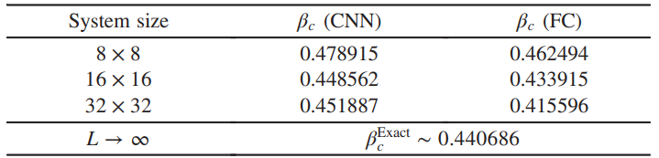



$$What method are we employing?$$
$$Convolutional neural network \left(CNN\right) is a machine learning \left(ML\right) technique,$$
$$the model detects spatial features on lattice like systems$$
$$while preserving spatial relationships. Here we$$
$$detect phase transition in the 2D lattice Ising model$$
$$We are motivated to use this technique since spin system configurations$$
$$are in the capabilities of CNN recognition as a simil to images.$$
$$What are the results?$$
$$CNN can detect phase transition in few \% accuracy$$
$$without explicit information of T_{c}$$
$$β_{c}^{exact}=\frac{1}{2}\log\left(\sqrt{2}+1\right)≈0.440686$$

Slide 4
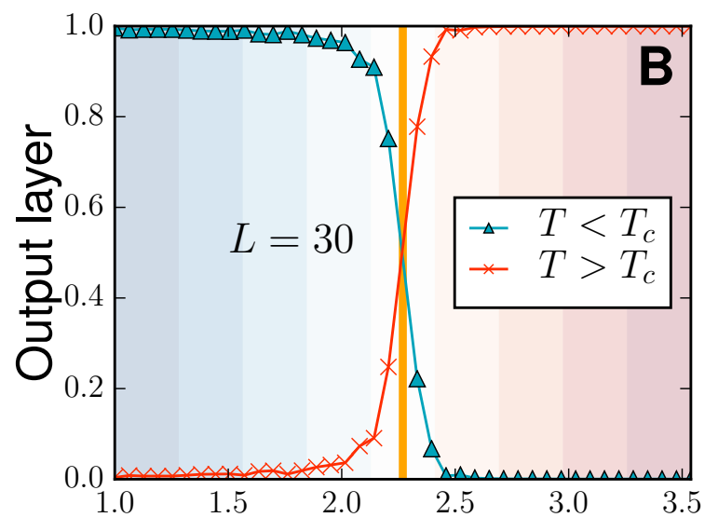
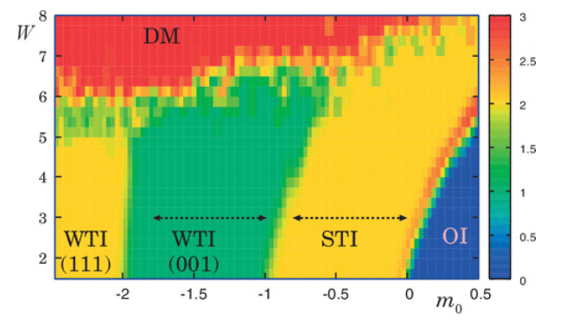





$$What kind of learning is it?$$
$$Unsupervised learning since it estimates critical temperature$$
$$with out prior knoledge$$
$Order parameter$
$Critical T$
$$What problems can CNN solve?$$
$Investigate phases of matters with great sucesses in 2d systems classification$
$Same for 3d systems$
$Phase diagram exploration$
$Unclear order parameter problems and measure difficult ones$
$$\left[Juan Carrasquilla, et al., 2016\right]$$
$$\left[Ohtsuki, et al. 2017\right]$$

Slide 5
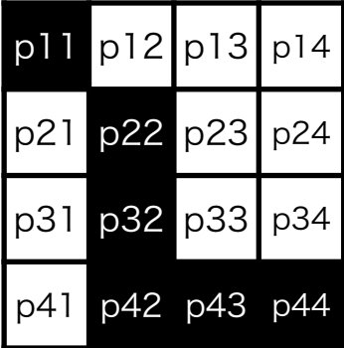
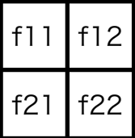

$$Convolution:$$
$$filtering with fitted filters (special sparse weights)$$
*
$Essentially same as the convolution in the Fourier transformation$
$Common usage in image processing and recognition$

Slide 6





Spin state at every 2D lattice point
$$y$$
Up: $σ_{x,y}=+1$
Down: $σ_{x,y}=−1$
$$x$$
$$\left\{σ\right\}:a spin conf, which is given by a probability,$$
$$P\left[\left\{σ\right\}\right]∝\exp\left[−βH\left[\left\{σ\right\}\right]\right], β∝T^{−1}$$
$$H=−\sum_{x,y}{σ_{xy}\left(σ_{\left(x+1\right),y}+σ_{x,\left(y+1\right)}\right)}$$

Slide 7
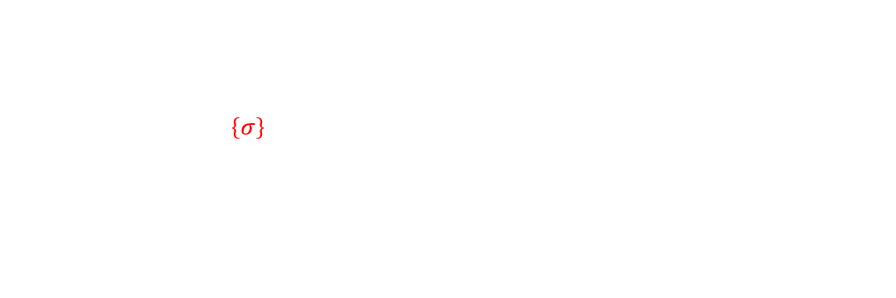
Spin state at every 2D lattice point
$$y$$
Up: $σ_{x,y}=+1$
Down: $σ_{x,y}=−1$
$$x$$
$$The expectation value of magnetization<σ>at inv. temp.$$
$$<σ> ∝\sum_{\left\{σ\right\}}{\sum_{x,y}{σ_{x,y}\exp\left[−βH\left[\left\{σ\right\}\right]\right]}}, difficult$$
$$<σ> ≠0, T<T_{c}$$
$$<σ> =0, T>T_{c}$$

Slide 8
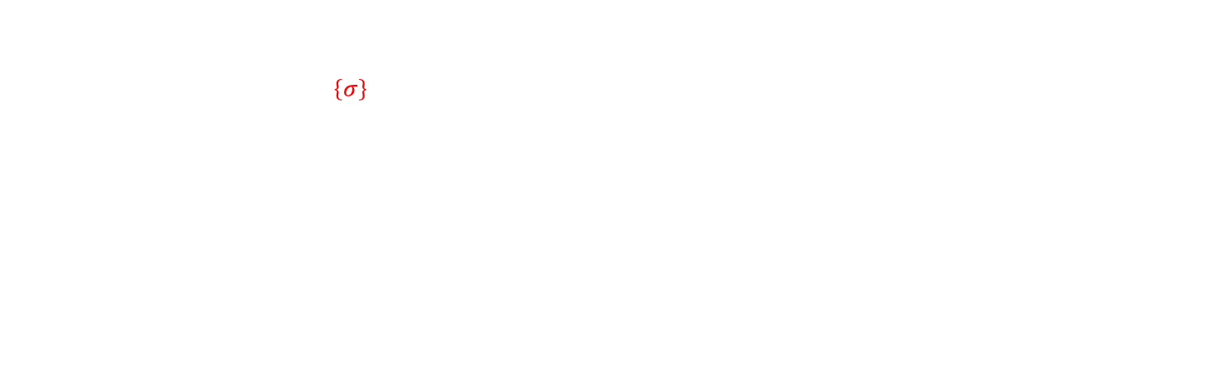
Spin state at every 2D lattice point
$$y$$
Up: $σ_{x,y}=+1$
Down: $σ_{x,y}=−1$
$$x$$
$$<σ> ∝\sum_{\left\{σ\right\}}{\sum_{x,y}{σ_{x,y}\exp\left[−βH\left[\left\{σ\right\}\right]\right]}}, difficult$$
$$H is invariant under σ→−σ but<σ> ≠0 can happen$$
$$σ is called \text{order} \text{parameter}, (spontaneous symmetry breaking)$$
$$Can we find phase transitions without taught order parameter?$$

Slide 9
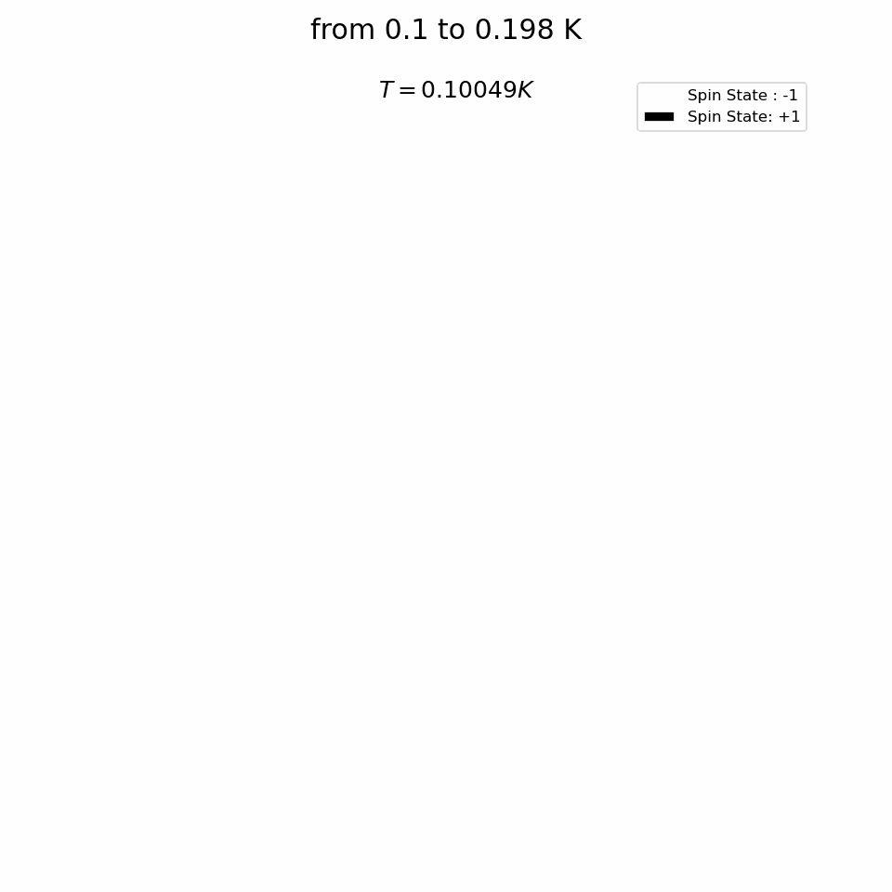
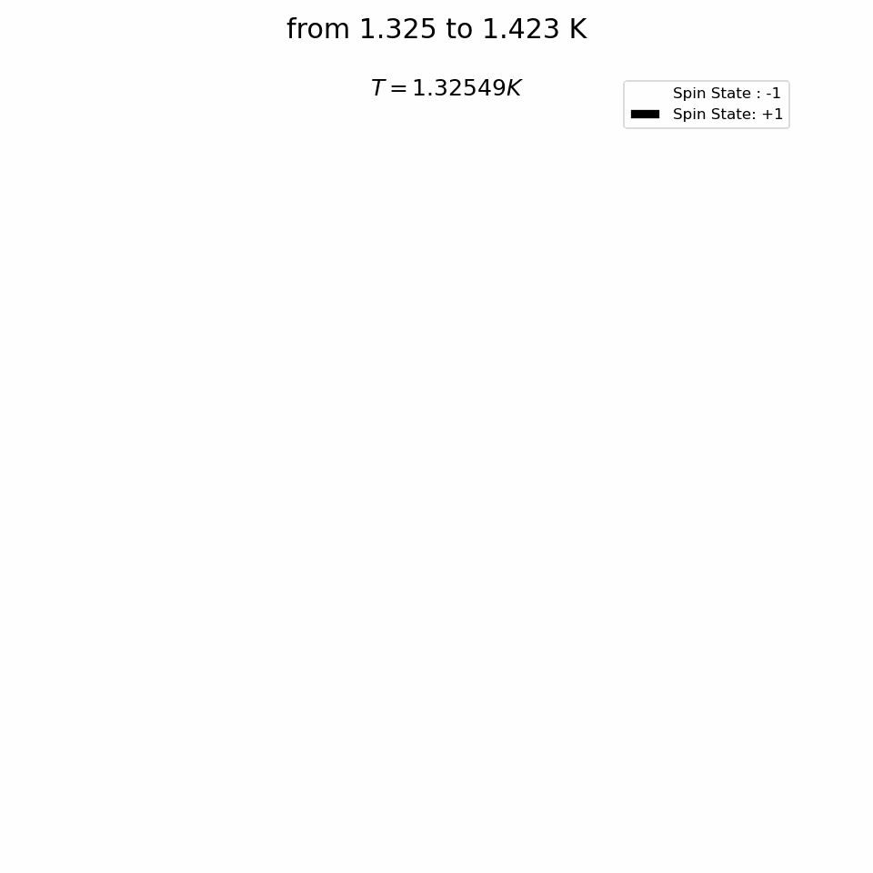
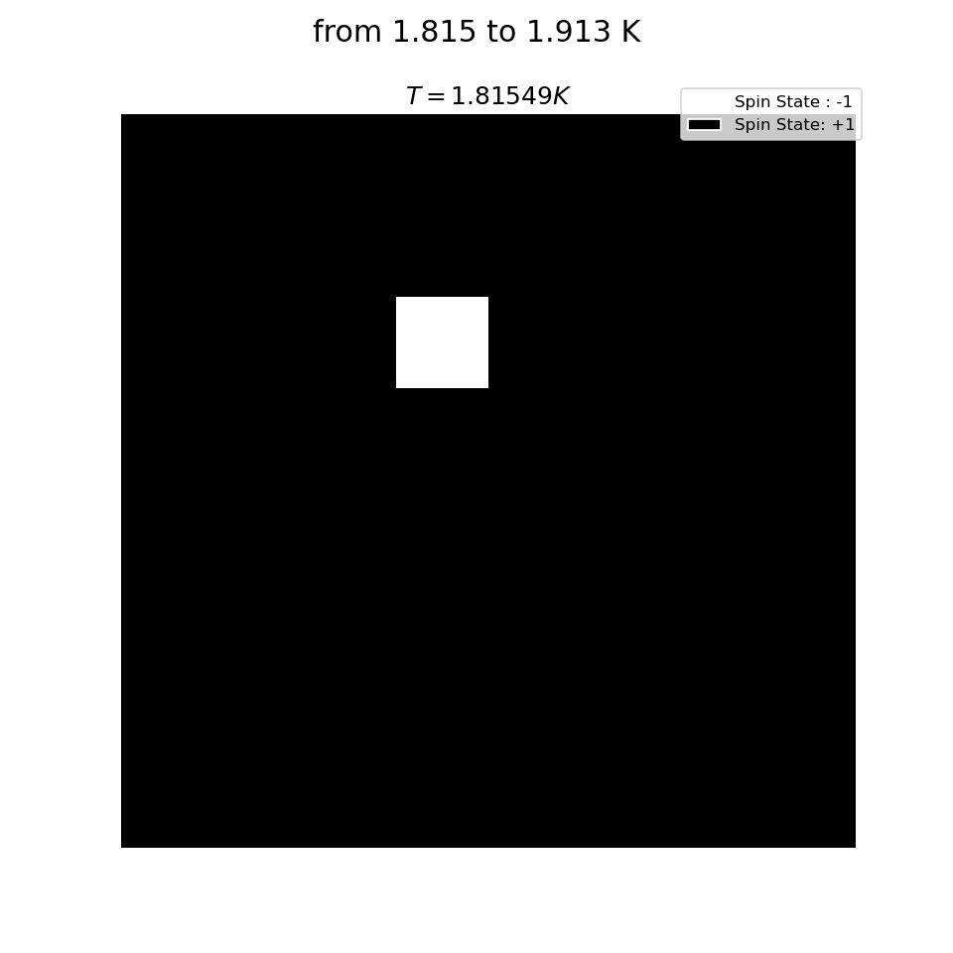
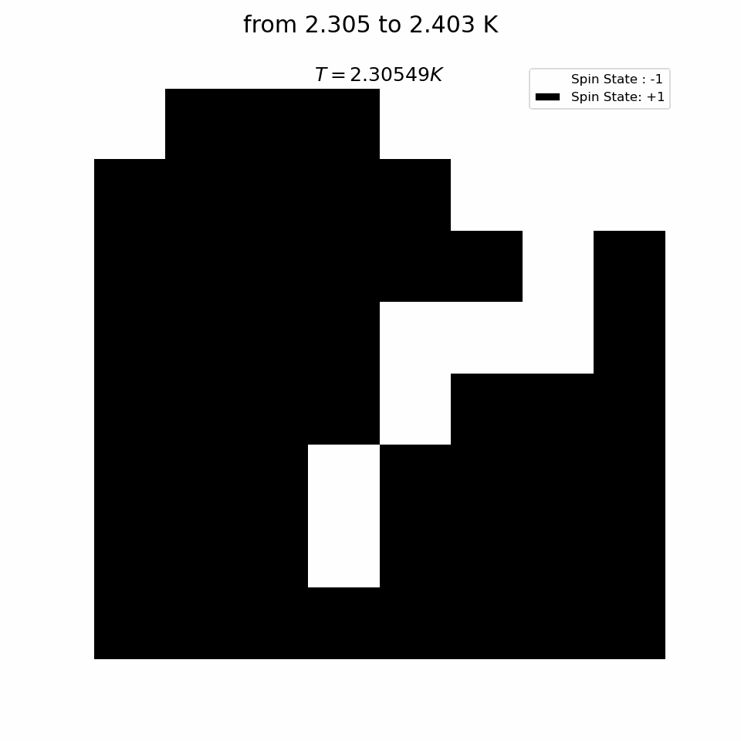
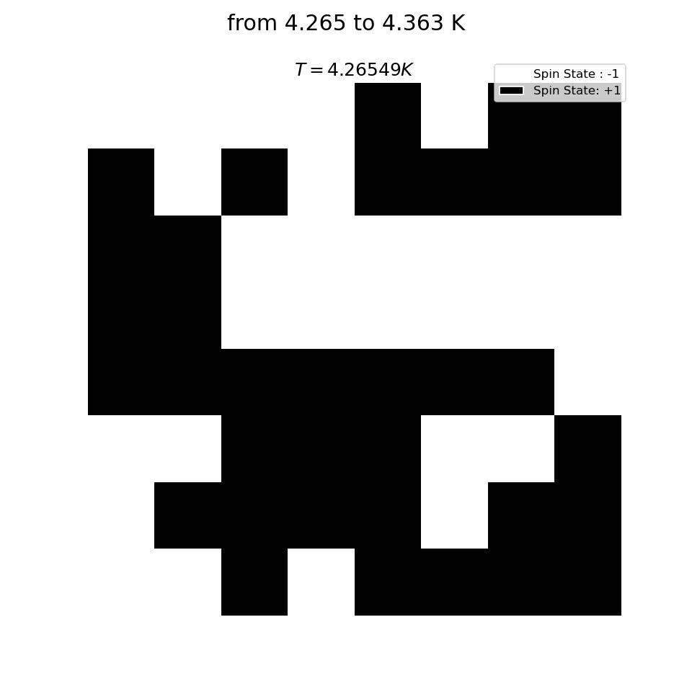



$$T_{min}=0.1, T_{max}=5.0, N_{conf}={10}^{4}$$
$$T_{L}=\left\{\left({\left\{σ\right\}}^{\left(n\right)},{\vec{β}}_{n}\right)\right|{\left|\frac{1}{β_{n}}=T_{min}+nδ\right\}}_{n=0,⋯,(N_{conf}−1)}$$
$$,δ=(T_{max}−T_{min})/N_{conf}$$
$$We apply negative magnetic field weakly to realize the unique ground state at zero temperature.$$
$$Therefore, almost all conf. at small temperatures are ordered \left\{σ\right\}=[−1,−1,⋯,−1]$$
$$T_{L} goes from ordered phase to disordered phase$$
$$t_{c}≈2.27, β_{c}≈0.44$$

Slide 10
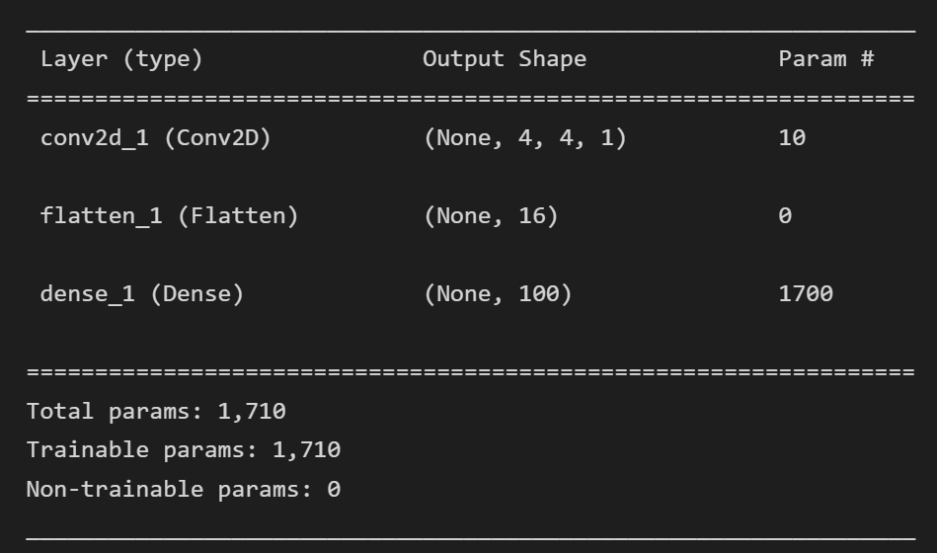
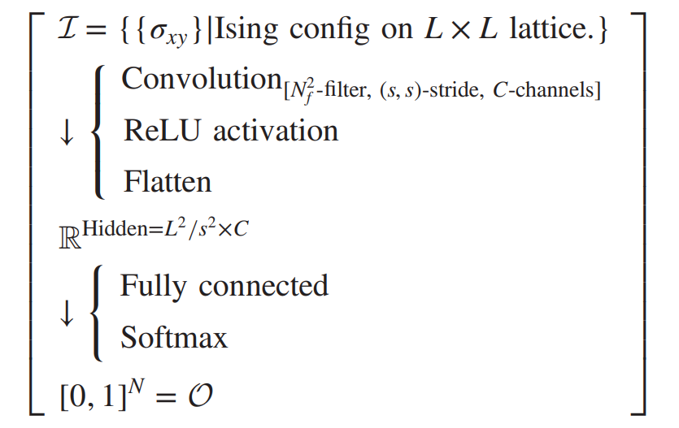
$$Small model already has good predictions$$
$$Summary shows important info for understanding architecture of NN and data changes there in between$$
$$Small model / lower capacity−Overfitting / memorization prevention$$
$$Not enough capacity?Room for experimentation$$

Slide 11
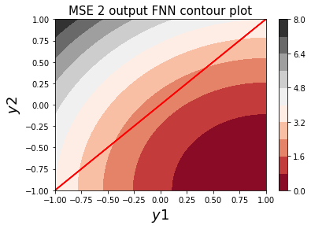
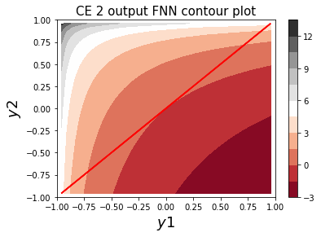
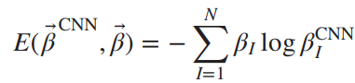




$$2 output nodes:t_{1}=1, t_{2}=−1$$
$$Max rule for classification$$
$$hit \left(correct\right) : y_{1}>y_{2}$$
$$Miss :y_{2}>y_{1}$$
1. $Decreasing MSE does not always give us a better classification$
$$E_{MSE}\left(0,0.1\right)<E_{MSE}\left(−0.8, −0.8\right)$$
2. $Movement from miss to hit region may take long time$
$$∇E_{MSE}∝N_{c}^{−1} (no steep)$$
$$Faster scape from miss region$$
$$∗However overspecialization clore to E_{CE}=0$$
$$∗[Sang−Hoon Oh, 2012]$$

Slide 12
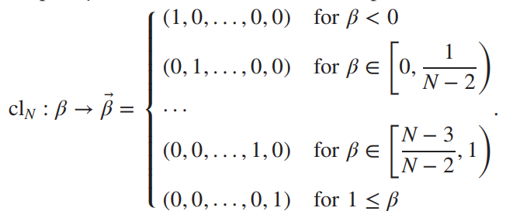
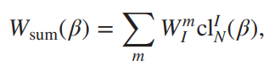
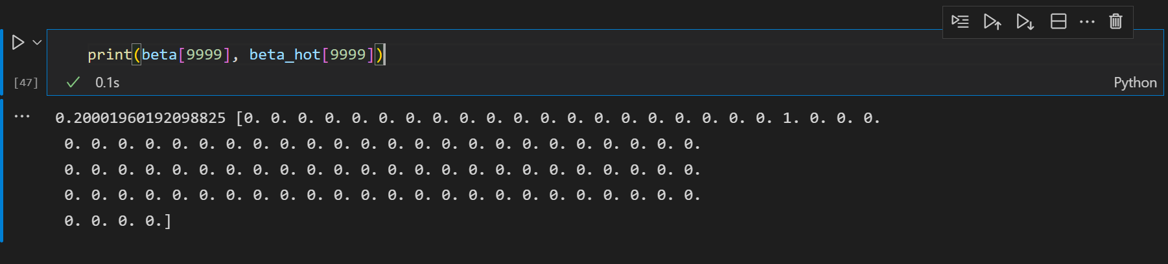




$$N=100, N_{f}=3, C=1, S=2, L=8$$
$$W_{I}^{m}:$$
$$m=1,⋯,\frac{8^{2}}{2^{2}}×1=16$$
$$I=1,⋯,100$$
$$F_{ij}^{a}:$$
$$a=1$$
$$i,j=1,⋯,3$$
$$Interval length$$
$$\frac{1}{N−2}=0.0102$$
$$And truncate the last class data \left(first 1837 points\right)$$
$$that affects fitting to$$
$$get critical inv. temp. estimate$$

Slide 13
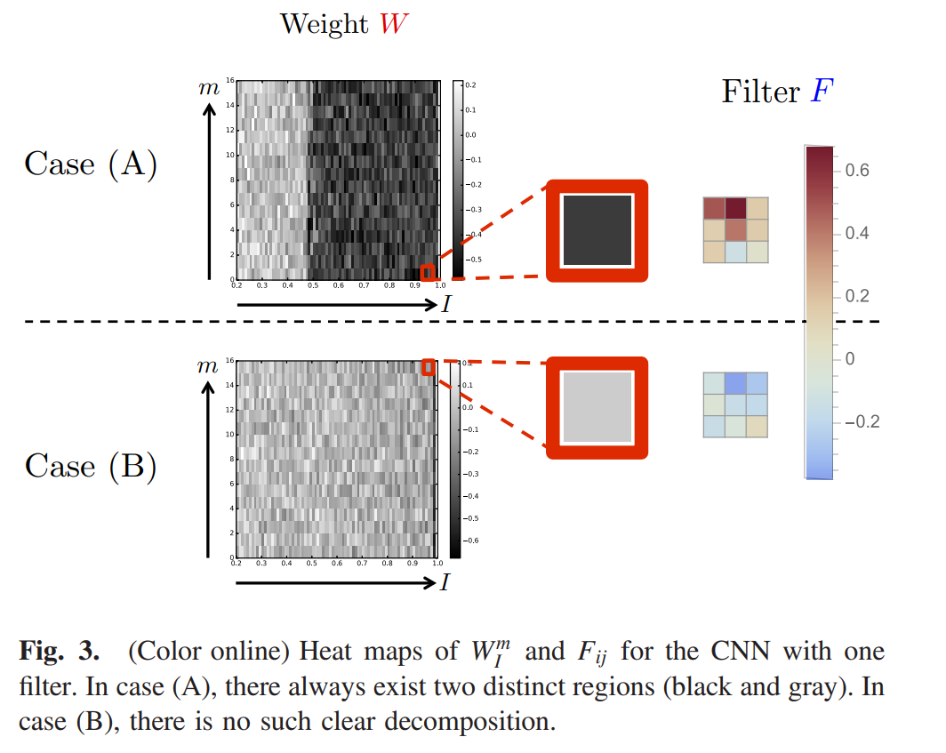

$$Examination of the boundary structure in heat map of weights$$
$$by defining order parameter, and estimation of inverse critical temperature by$$
$$fitting distribution of the order parameter$$

Slide 14
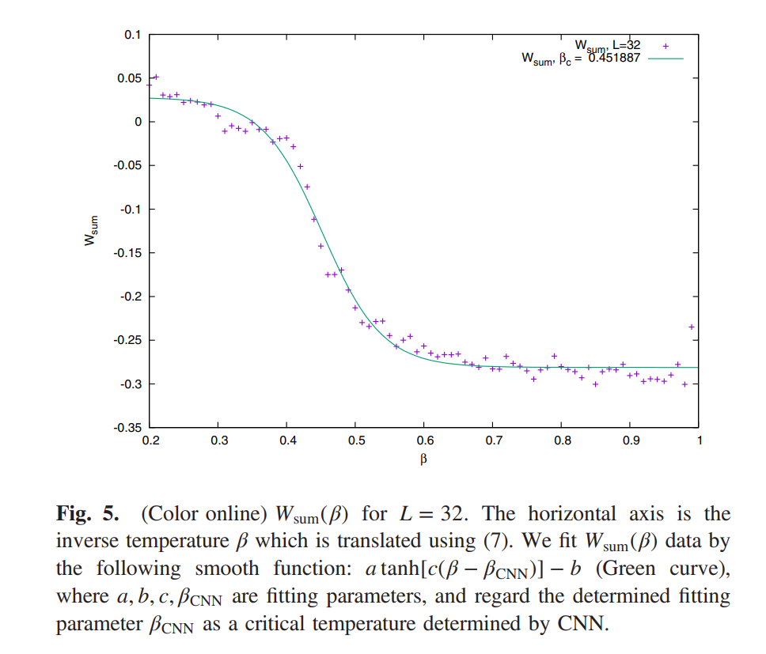
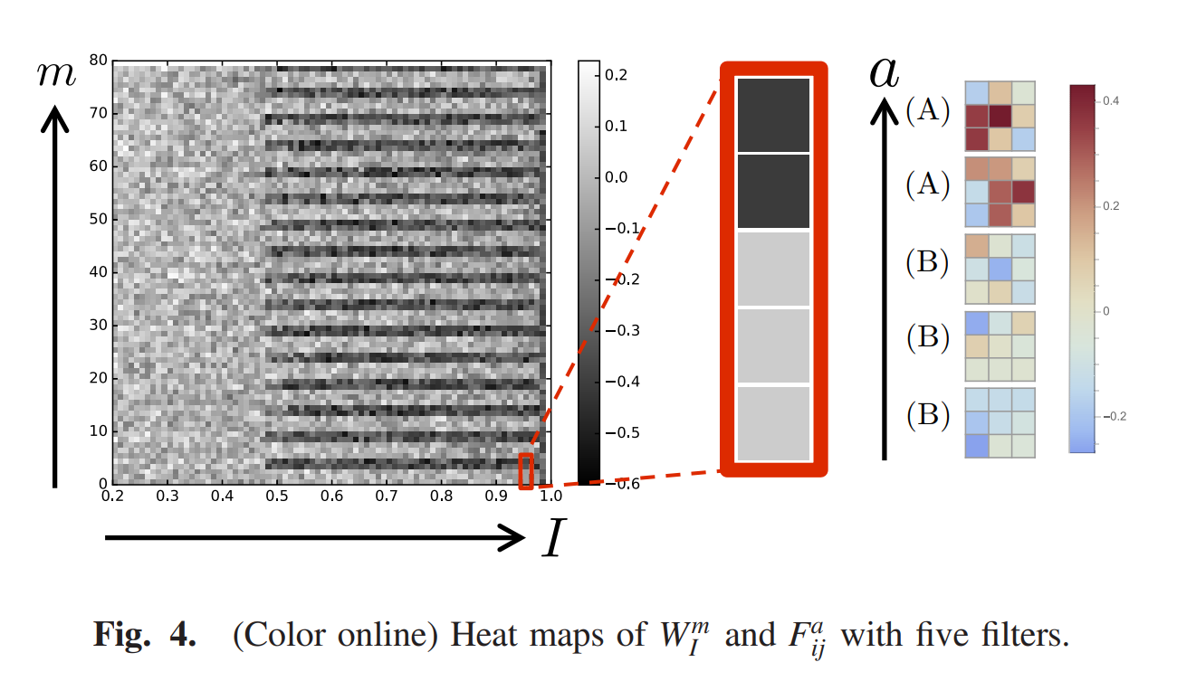

Slide 15
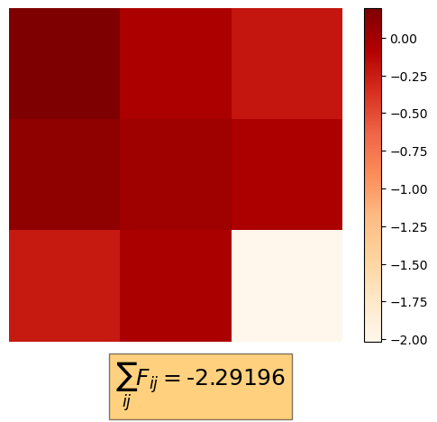
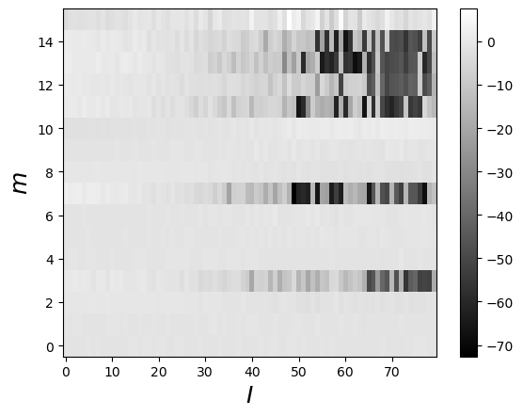
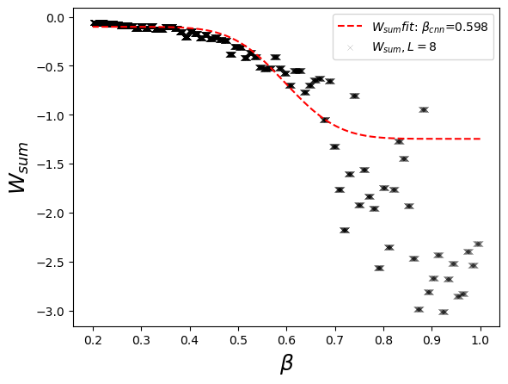
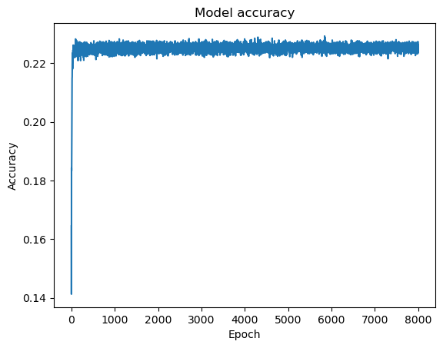

Slide 16
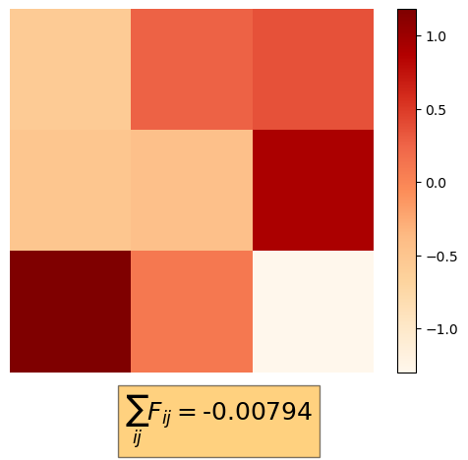
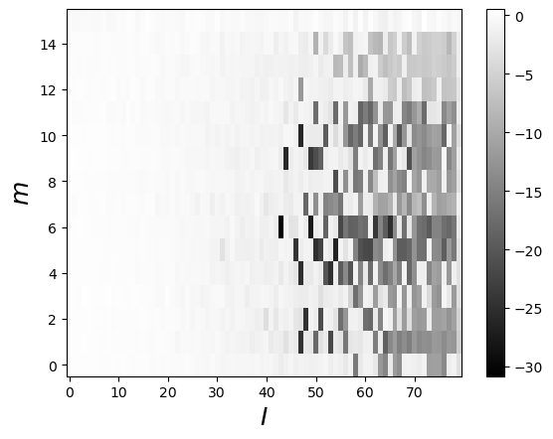
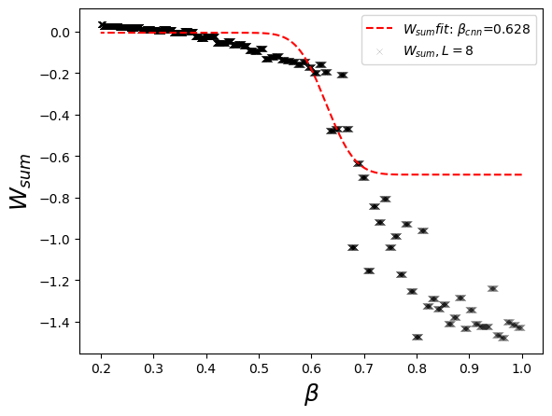
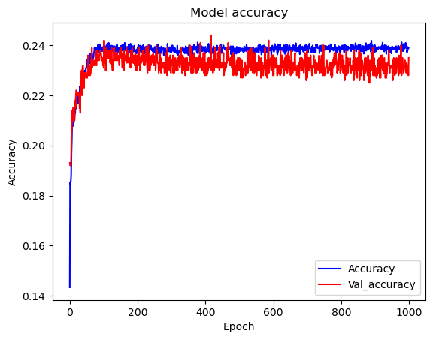
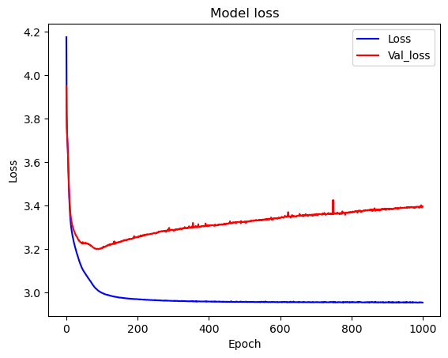

Slide 17
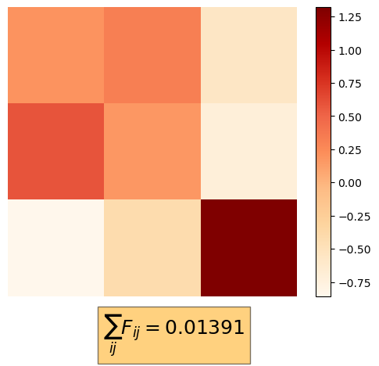
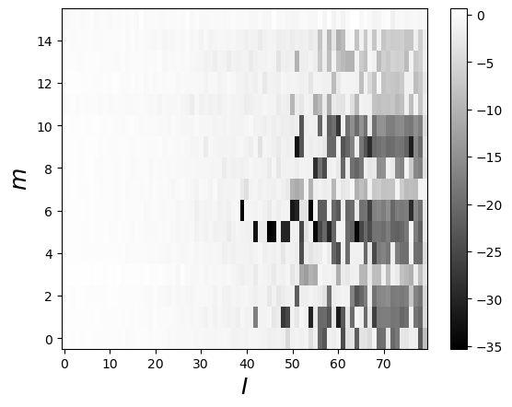
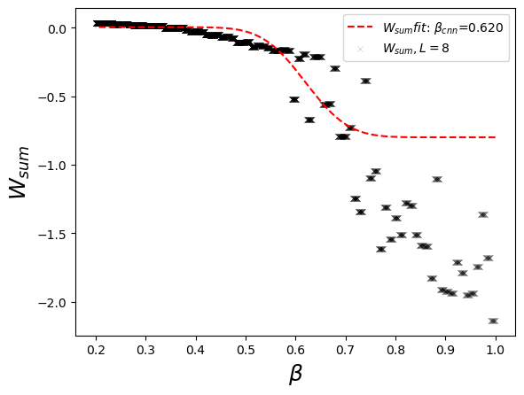
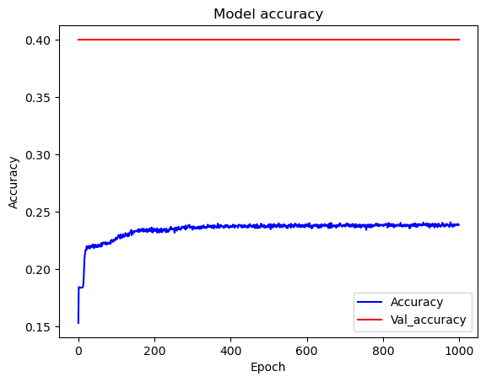
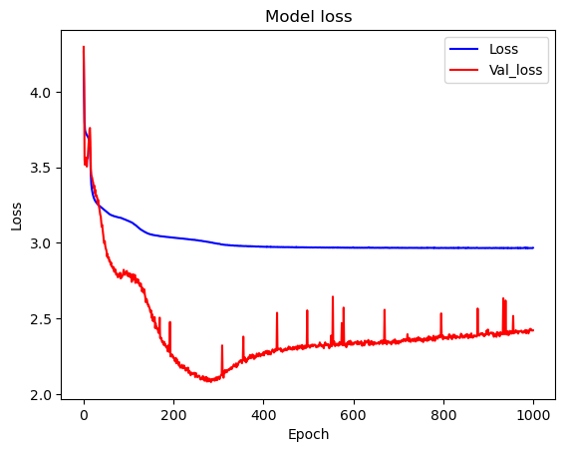

Slide 18


$$Abstract$$
$The design of a simple arquitecture is supposetly enough to study correlation$
$$between correlation of Ising configurations and inv. temp.$$
$Weights W from DNN captures features of phase transition$.
$Fitting of W_{sum} by the mean field approximation of the Ising magnetization$
$$close in critical temp.$$
$The latter up to 2−8\% accuracy.$
$The models prediction is independent of its accuracy$
$The used model could converge to correct prediction way before it finds domain−like boundary$
$Deeper observation over the training means posibility of improvement$

Slide 19
References
[1] Oh, Sang-Hoon. (2012). Contour Plots of Objective Functions for Feed-Forward Neural Networks. International Journal of Contents, 8(4), 30–35. https://doi.org/10.5392/IJOC.2012.8.4.030
[2] Ising models: Juan Carrasquilla and Roger G. Melko arXiv: 1605.01735

